Slide 1
Health Risk Insights: A Data-Driven Analysis of Insurance Claims and Patient Profiles
Project Overview: Health Insurance Exploratory Data Analysis
This project involves analyzing a health insurance dataset to extract meaningful insights. The dataset contains various attributes such as age, gender, body mass index (BMI), blood pressure, diabetic status, smoking habits, the number of children, and insurance claim amounts. The goal is to explore the relationships between these variables, identify key patterns, and provide actionable insights for improving health insurance decisions.
Tools Used;
Exploratory Data Analysis (EDA) : Visualizations (scatter plots, bar plots, box plots), and identifying patterns.
Python Programming (pandas, numpy, seaborn, matplotlib)

Slide 2
Project Objectives
Analyze Patient Demographics: Investigate the distribution of gender, age, and region to understand the demographic composition of the patients.
Assess Health Indicators: Study BMI and blood pressure across different patient groups to identify common health trends or risk factors.
Evaluate Lifestyle Impacts: Examine the effects of smoking, diabetes, and the number of children on health outcomes like BMI and blood pressure.
Insurance Claims Analysis: Explore the relationship between patient characteristics and insurance claim amounts to detect any patterns influencing claim costs.
Correlation Analysis: Use a heatmap to understand the correlations between variables such as age, BMI, blood pressure, smoking, diabetic status, and insurance claims.
Predictive Insights: Identify which factors might be strong predictors of high insurance claims.

Slide 3
Project Analysis Summary
1. Age and Blood Pressure by Gender
Key Insight: A scatter plot shows that blood pressure tends to increase with age, but there is no clear difference between males and females in terms of blood pressure.
Actionable Insight: Target preventive healthcare programs focused on high blood pressure for older individuals across all genders.
2. Gender and Smoking Status
Key Insight: Smokers are more likely to be male than female, and smoking could correlate with higher BMI and blood pressure in some cases.
Actionable Insight: Insurance companies may want to introduce incentives or premium reductions for non-smokers, especially males, to encourage healthier lifestyles.
3. BMI and Claim Amount
Key Insight: BMI shows a positive correlation with claim amounts, indicating that patients with higher BMI tend to file higher insurance claims.
Actionable Insight: Insurance policies may include wellness programs for patients with higher BMI to reduce long-term claim costs.

Slide 4
Pros and Cons of the Analysis
Pros
Cons
Comprehensive Data: The dataset provides a variety of features (age, BMI, smoking, diabetes, etc.) that allow for a detailed analysis of multiple aspects of health and insurance claims.
Actionable Insights: The analysis provides actionable recommendations for insurance providers to optimize their policy offerings based on patient demographics and health conditions.
Data Correlation: The heatmap reveals the strength of relationships between variables, which can guide further analysis and decision-making.
Missing Data: There are some missing values, particularly in the age column. This can affect the reliability of certain analyses.
Limited Geographical Information: The dataset only categorizes regions into broad categories like "northwest" and "southeast," which limits geographic-specific insights.
No Longitudinal Data: The dataset is static, meaning it doesn't track patients over time. Therefore, it is difficult to make predictions about long-term health outcomes.

Slide 5
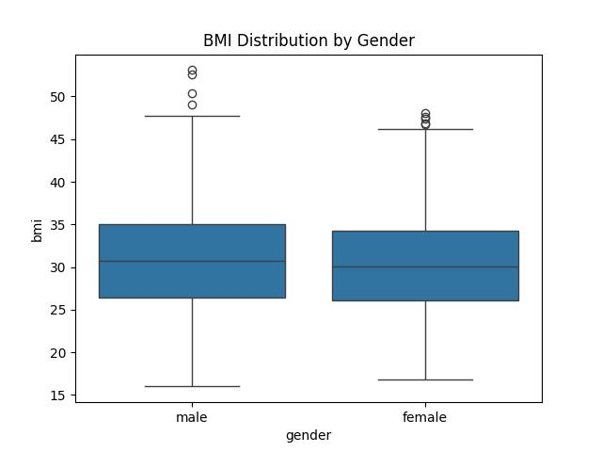
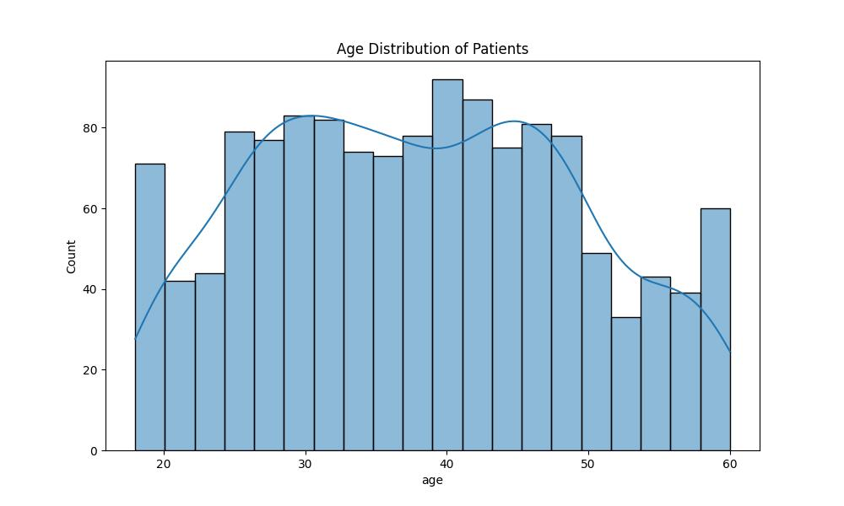
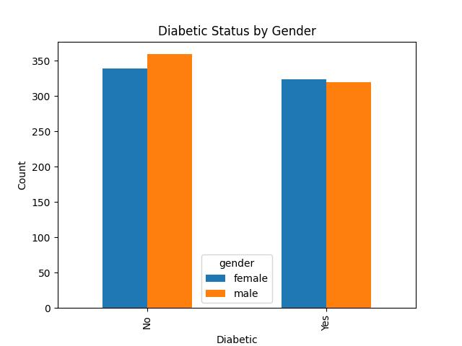
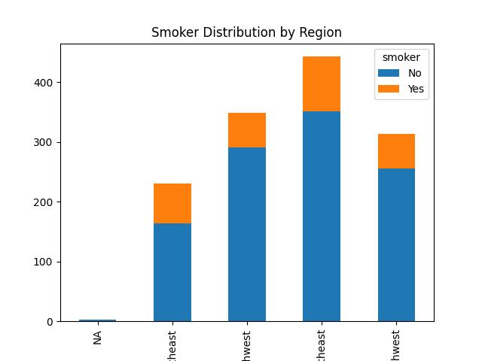
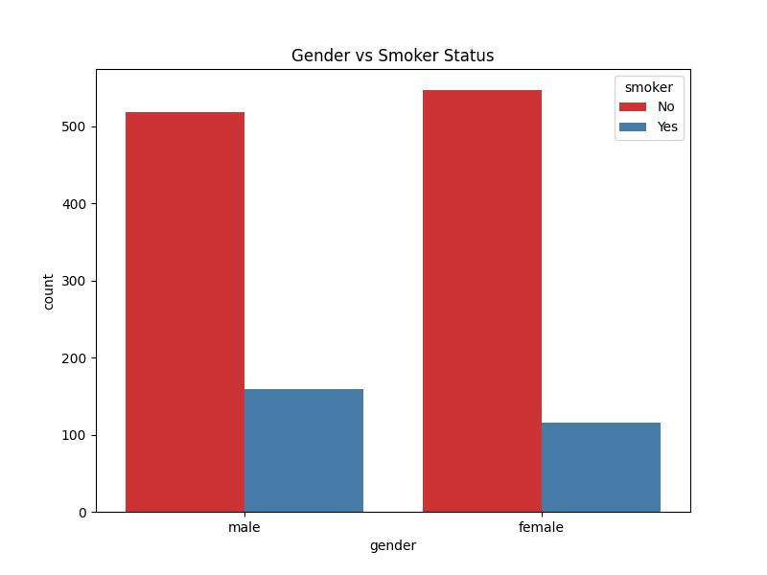
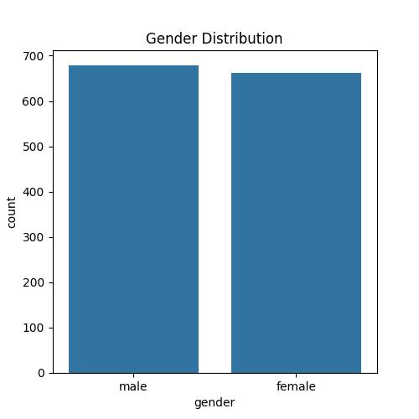

Slide 6
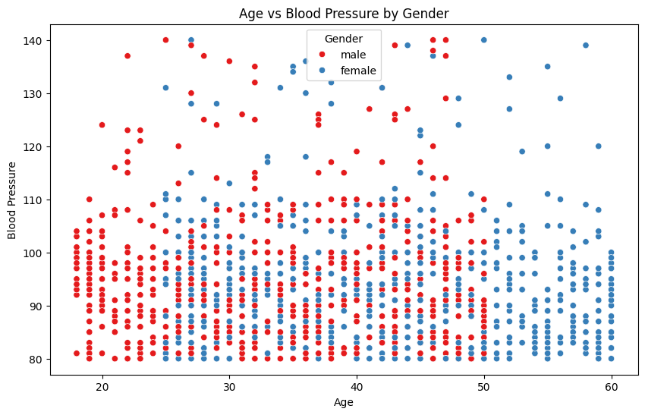

Slide 7
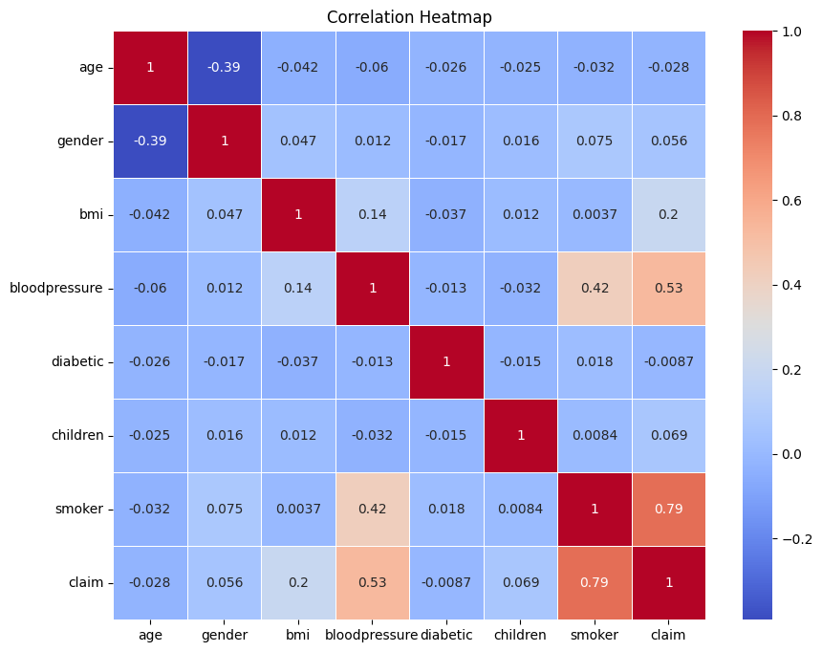
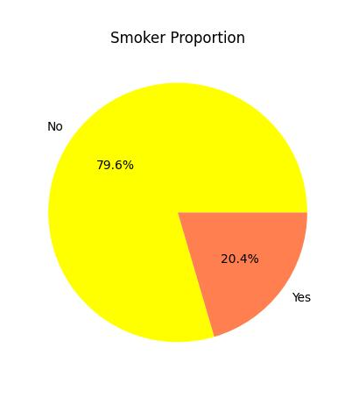

Slide 8
Summary
Demographics and Health: The project analyzes patient data, focusing on age, gender, BMI, blood pressure, and diabetic status.
Smokers and Claims: Smokers, especially males, tend to file higher insurance claims.
BMI and Blood Pressure: Higher BMI and blood pressure are linked to larger insurance claims.
Diabetes Trends: Diabetic patients often have higher BMI and blood pressure but show mixed results regarding claim amounts.
Insurance Insights: The analysis suggests insurers should focus on high-risk groups like smokers and those with higher BMI and blood pressure.

